Slide 1
Efsa Sema Aktay
FINAL PROJECT PROPOSAL
DESN 3002 – Instructor: KAM-MING MARK TAM

Slide 2
PROBLEM STATEMENT
How can we predict the future stock price movements of HKSI (hang seng index) with 65%+* accuracy using different types of machine learning algorithms and diverse data such as past price information?
Efsa Sema Aktay
Reference: https://cs229.stanford.edu/proj2013/FuChenWei-HongKongStockIndexForecasting.pdft of body text

Slide 3
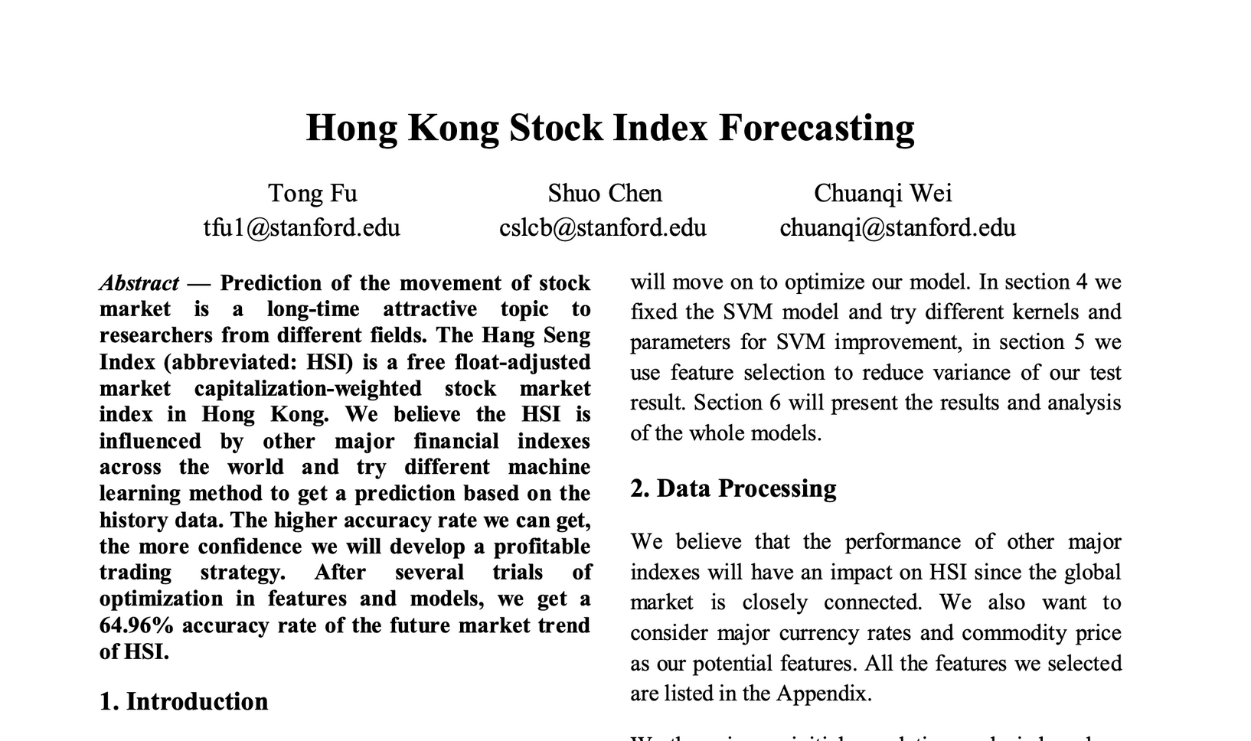
REFERENCE STANFORD PAPER
Efsa Sema Aktay

Slide 4
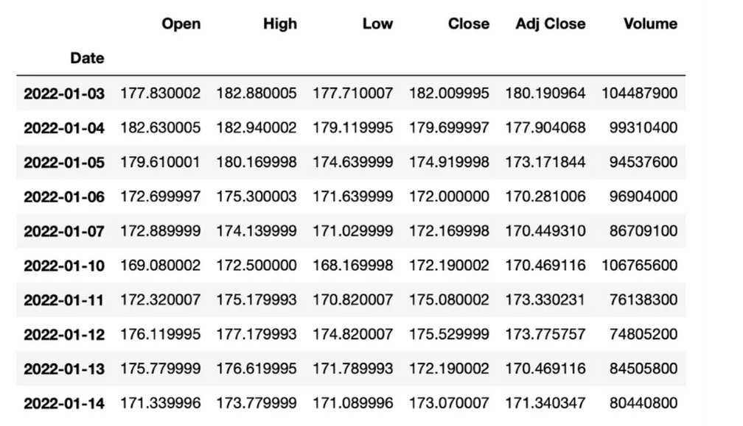
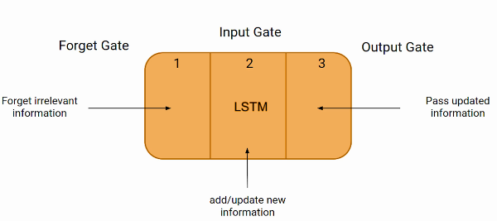
PROBLEM STATEMENT
Design Space:
Algorithm type: SVM, Neural Network, LSTM
Input features: Price history, technical indicators, macro factors, news, social media, etc.
Data preprocessing: Scaling and lags
Model hyperparameters: Layer sizes, kernels, optimizers
Evaluation metrics: Accuracy, ROC AUC, precision/recall
Design Variables:
Stock Price History Timeline
Algorithm(s) to test
Data preprocessing techniques
Train/test data splits
Reference1 : https://cs229.stanford.edu/proj2013/FuChenWei-HongKongStockIndexForecasting.pdft of body text
Reference 2 image bottom :https://www.analyticsvidhya.com/blog/2021/03/introduction-to-long-short-term-memory-lstm/
Reference 3 image top: https://medium.com/@miryam.ychen/predicting-stock-prices-with-machine-learning-a-deep-dive-8f80bfd585cd
Efsa Sema Aktay
Notes:
Accuracy: Percentage of correct predictions. Best for balanced classes but can be misleading otherwise.
Precision/Recall: Measure correct positive predictions. High precision means few false positives, high recall means few false negatives.
ROC AUC: Probability that model ranks a random positive higher than a random negative. Combines true/false positives and negatives.
Confusion Matrix: Shows distributions of actual vs predicted class assignments in a table for more detailed analysis.
F1 Score: Harmonic mean of precision and recall. Captures model effectiveness when both are important.
earning rate: Controls how quickly the model learns from examples during training. Too high can cause divergence, too low leads to slow learning.
Number of epochs: Number of full passes through the training dataset during learning. More epochs often improves performance but can lead to overfitting.
Batch size: Number of examples used in one iteration of gradient descent. Larger sizes reduce training time but high values can increase variance.
Hidden layers/units: Numbers of nodes in each hidden layer for neural networks. More layers/nodes allow more complex patterns but also more parameters to optimize.
Activation function: Transforms node output in hidden layers (e.g. sigmoid, tanh, ReLU). Impacts what types of patterns the network can represent.
Regularization: Penalties added to avoid overfitting (e.g. L1, L2, dropout). Reduce complexity but hurt performance if set too high.

Slide 5
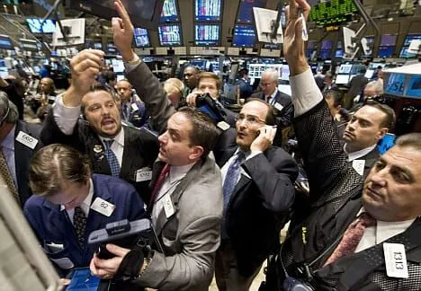
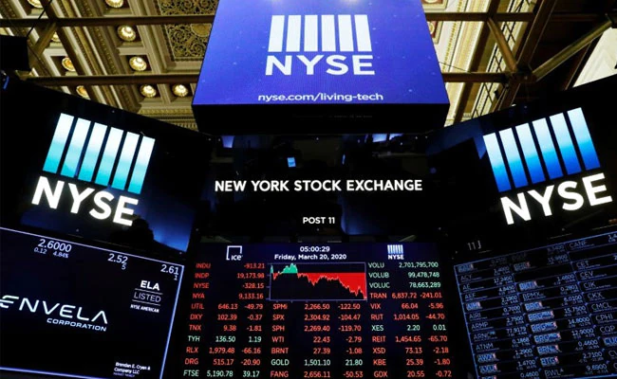
THE STOCK MARKET AND INFORMATION FLOW:
"open outcry"
computerised system
The flow of information on the trading floors where the stocks are bought and sold has gotten increasingly faster in the last 8-10 years with the aid of improvements in technology.
Efsa Sema Aktay
Reference 1 outcry image: https://www.strike.money/stock-market/open-outcry
Reference 2: nyse image from nyse website

Slide 6
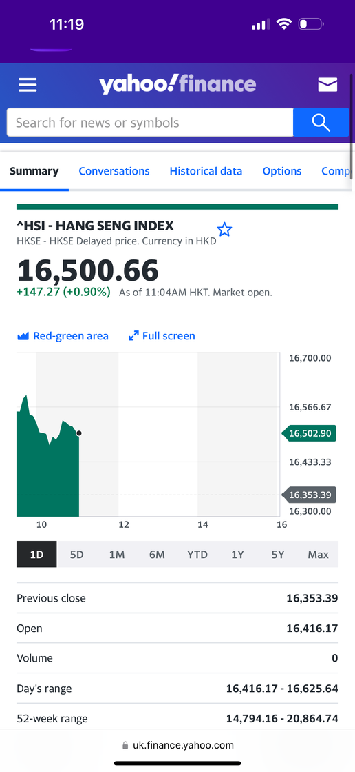
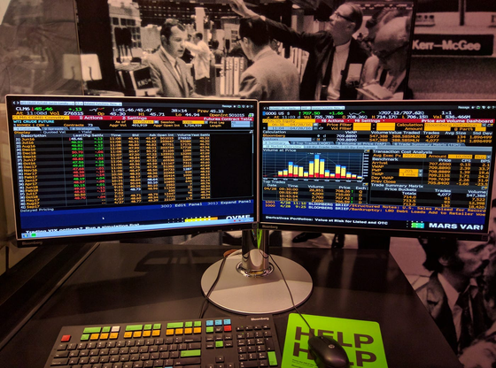
WHY DOES THIS MATTER?
1-Time value of money
Hundred dollars today is worth more than Hundred dollars a year from now.
2- Efficient markets theory
According to this theory, all the information is priced into the markets. However, this is not all correct in real-life scenarios creating opportunities for profit opportunities.
3- Time Delay in Information
Today, quantitative firms and trading firms use quantitative strategies to execute trades and serve their clients. The information available to public for free on yahoo finance generally tends to have delay in information compared to paid platforms like Morningstar and Bloomberg.
Summary: As a result, if we can evaluate and predict stock market movements with some degree of accuracy it will benefit the industry in how firms serve their clients and invest their money.
Efsa Sema Aktay

Slide 7

KEY INSIGHT FROM PREVOUS CASE STUDY
Using an outsourced model that is in progress of development - Beta Version
little documentation about functions or components
when encountering an error difficult to troubleshoot
beta version so a lot of issues with component data
My interest in utilising Machine Learning Models for analysis
machine learning models require large amounts of data to accurately predict an outcome
there should be enough generated data to train and test the model
finance data is very accessible and well documented
Industry impact and learning aspect
By choosing a finance topic and Python I can control the algorithms more easily and also achieve better visualisation of data as well as learning more about my expertise combining it with design
Compared to floor layout generators most algorithm/machine learning stock price prediction journals have been published within the last three years or relatively more current
Efsa Sema Aktay

Slide 8
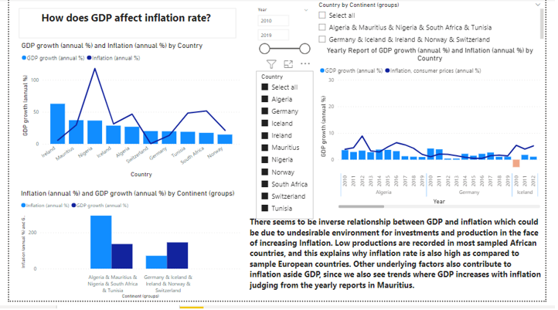
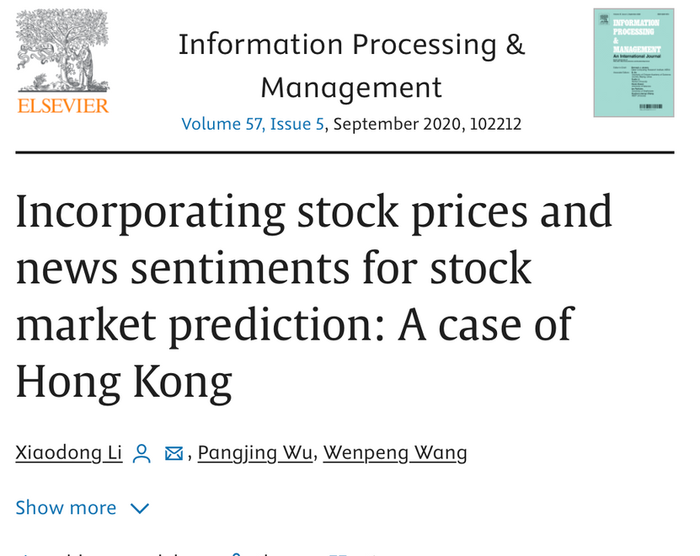
REFLECTION/LIMITATIONS
What additional financial/economic factors could improve predictions?
Exchange rates, GDP, interest rates etc.
How to address challenges like inflation, volatility, and black swan events?
What evaluation strategies can be used to validate model performance?
Which additional data sources I can incorporate to increase the robustness of the model?
LEARNING AND UNIQUENESS
According to “ Incorporating stock prices and news sentiments for stock market prediction: A case of Hong Kong” although the stock price examination based on previous price movements is common incorporating different types of data and multivariable factors is quite new to the field.
Reference 1 article below : https://www.sciencedirect.com/science/article/abs/pii/S0306457319307952
Reference 2 image above: https://medium.com/@julietoranebo/interactive-dashboard-design-of-data-analysis-of-gdp-inflation-and-international-trade-of-sample-97a4d1ef5da2
Efsa Sema Aktay

Slide 9
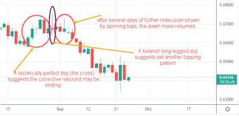
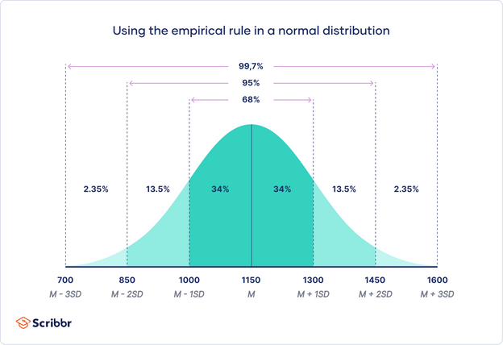
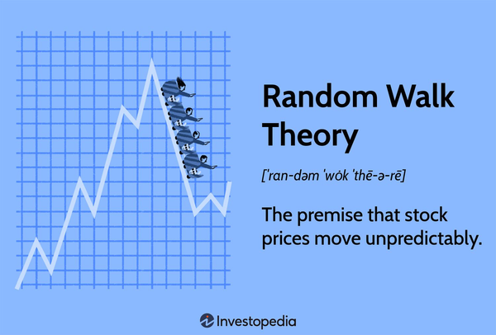
EVALUATION
Accuracy: Percent correct predictions of up/down movements over the validation period
Validate against the Random Walk principle
Tools: I am planning on using Google Collaboratory and TensorFlow.
These platforms utilise Python to run Machine Learning Algorithms.
Efsa Sema Aktay
Reference 1 image bottom right: https://www.investopedia.com/terms/r/randomwalktheory.asp
Reference 2 image bottom left: https://www.scribbr.com/statistics/normal-distribution/
Reference 3 image top: https://www.investopedia.com/articles/active-trading/092315/5-most-powerful-candlestick-patterns.asp

Slide 10

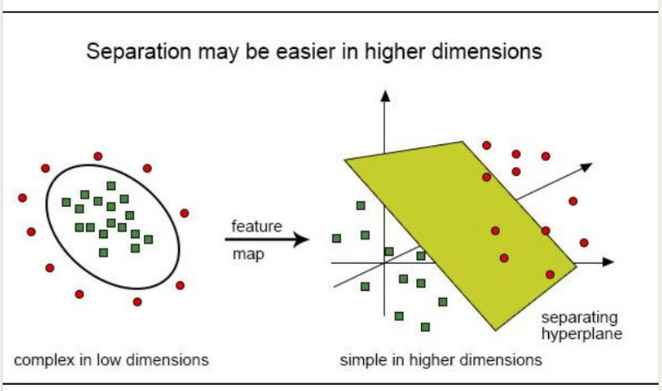
TIMELINE & PLAN
Week 1: Tutorials and Learning of LTSM Models
Week 2:Data collection & preprocessing
Week 3: Validating the Model
Week 4: Final Analysis and Reworking the Model into Other Markets and Further Analysis
WHATS MORE?
Testing the model on other APAC market
Comparing a certain industry across emerging markets
Utilising the model to compare the Singapore/HK stock market
Looking into Algorithmic Trading
Submit to HKU Business School Journal
Submit to the Fintech Department
Efsa Sema Aktay
Reference 1 image bottom right: Linkedin PyQuants post

Slide 11
THANK YOU!
Efsa Sema Aktay
DESN 3002 – Instructor: KAM-MING MARK TAM

